Slide 1
Sort Battle & Maze Solver
Here is where our presentation begins
-> Arpan Gyawali(075BCT014)
-> Bidhan Khatiwada(075BCT018)
-> Bijaya Shrestha(075BCT020)

Slide 2
01
04
02
05
Table of Contents
03
06
Objective
Project Overview
Introduction
Dependencies
Algorithms
Demo

Slide 3
Objectives
To create a project on Data Structure and Algorithms to make its concept clearer.
To be familiarized with graphics programming using SFML in C++.
To visualise Sorting and Path Finding Algorithms using graphics.
To make us able to work in major projects in coming futures.
To learn to work in team.

Slide 4
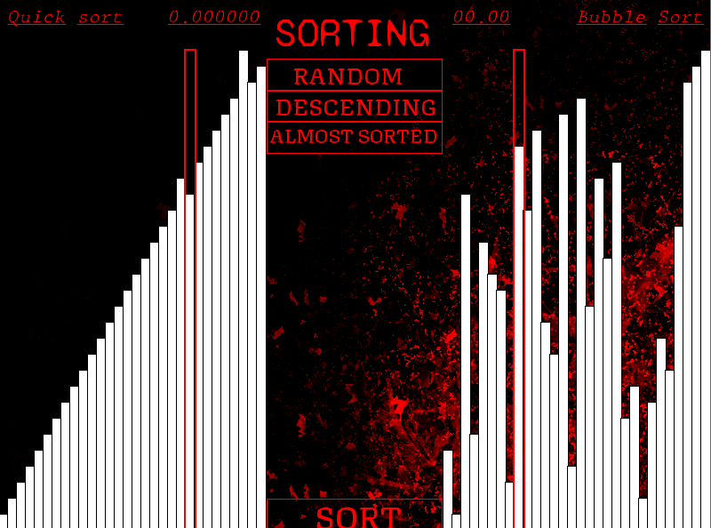
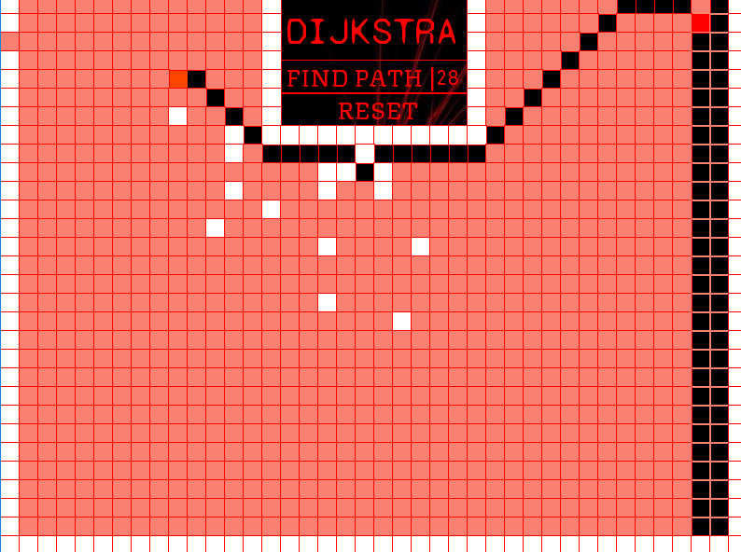
Introduction
As the name suggests, our project is focused on visualising various sorting and path finding algorithms.
The algorithms present in our project are:
Bubble Sort Dijkstra Shortest Path Finder
Quick Sort
Insertion Sort
Shell Sort

Slide 5

Introduction
Bubble Sort
Quick Sort
Bubble Sort is a simplest sorting algorithm that works by repeatedly swapping the adjacent elements if they are in wrong order.
Quick Sort is a Divide and Conquer algorithm. It picks an element as pivot and partitions the given array around the picked pivot element.
Dijkstra
Dijkstra is an algorithm for finding the shortest paths between nodes in the graph. It creates a tree of shortest paths from the starting vertex, the source, to all other points in the graph.
Insertion Sort
Shell Sort
In insertion sort is a simple array is virtually split into a sorted and an unsorted part. Values from the unsorted part are picked and placed at the correct position in the sorted part.
This algorithm uses insertion sort on a widely spread elements, first to sort them and then sorts the less widely spaced elements. This spacing is termed as gap.

Slide 6
Algorithm
Quick Sort
Partition
Step 1 - Choose the highest index value has pivot .
Step 2 - Take two variables to point left and right of the list excluding pivot
Step 3 - left points to the low index
Step 4 - right points to the high
Step 5 − while value at left is less than pivot move right Step 6 Step 6 − while value at right is greater than pivot move left
Step 7 − if both step 5 and step 6 does not match swap left and right
Step 8 − if left ≥ right, the point where they met is new pivot
Sorting
Step 1 − Make the right-most index value pivot
Step 2 − partition the array using pivot value
Step 3 − quicksort left partition recursively
Step 4 − quicksort right partition recursively

Slide 7
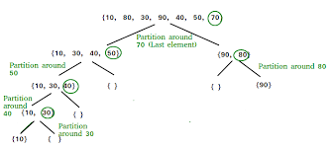
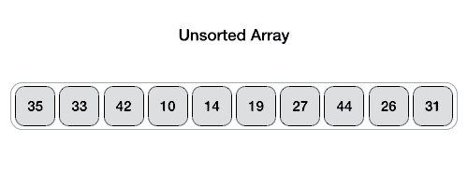
Algorithm

Slide 8
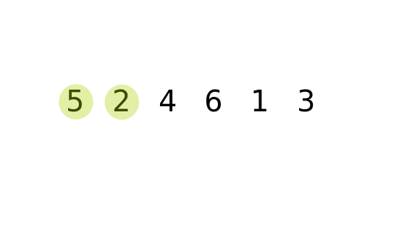
Algorithm
Bubble Sort
Step 1 – start from the first index
Step 2 - compare the current element with the next element of the array.
Step 3 – if the current element is greater than the next element of the array, swap them.
Step 4 - if the current element is less than the next element, move to the next element.
Step 5 − continue these steps until second last index

Slide 9
Algorithm
Dijkstra
Step 1 - Create a set sptSet (shortest path tree set) that keeps track of vertices included in shortest path tree, i.e., whose minimum distance from source is calculated and finalized. Initially, this set is empty.
Step 2 - Assign a distance value to all vertices in the input graph. Initialize all distance values as INFINITE. Assign distance value as 0 for the source vertex so that it is picked first.
Step 3 - While sptSet doesn’t include all vertices
a) Pick a vertex ‘u’ which is not there in sptSet and has minimum distance value.
b) Include ‘u’ to sptSet.
c) Update distance value of all adjacent vertices of ‘u’. To update the distance values, iterate through all adjacent vertices. For every adjacent vertex ‘v’, if sum of distance value of ‘u’ (from source) and weight of edge u-v, is less than the distance value of ‘v’, then update the distance value of ‘v’.

Slide 10
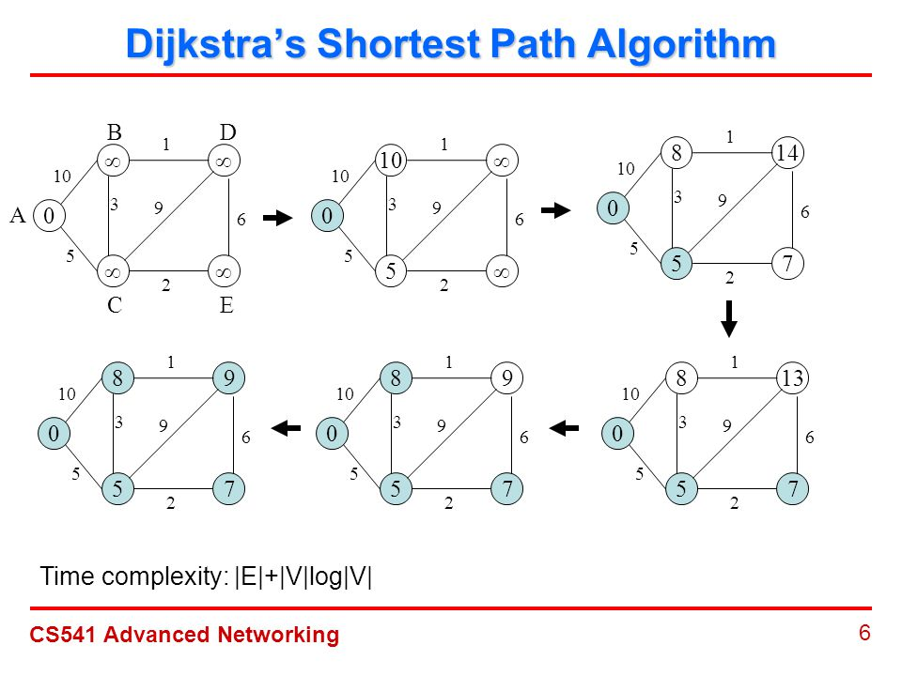
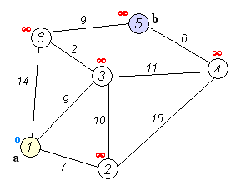
Algorithm

Slide 11
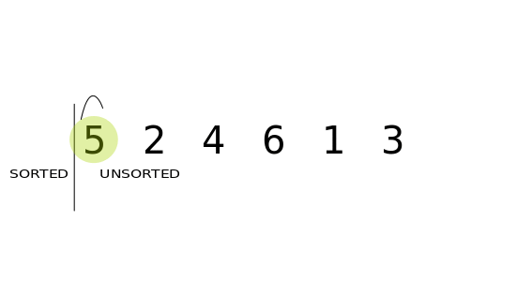
Algorithm
Insertion Sort
Step 1 – Iterate from arr[1] to arr[n] over the array.
Step 2 - Compare the current element (key) to its predecessor.
Step 3 – If the key element is smaller than its predecessor, compare it to the elements before.
Step 4 - Move the greater elements one position up to make space for the swapped element.

Slide 12
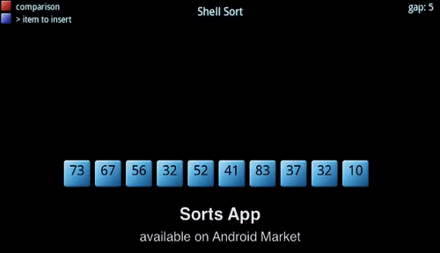
Algorithm
Shell Sort
Step 1 – Initialize the value of gap(N/2,N/4,…).
Step 2 - Divide the list into smaller sub-list of equal interval gap.
Step 3 – Sort these sub-lists using insertion sort.
a) If swapping is done, check the element backwards.
Step 4 - Repeat until complete list is sorted .

Slide 13
Project Overview
Sort Battle
Here, the screen is divided into two battleground. Based on any two algorithms among four(Bubble, Quick, Shell, Insertion) and the orientation(Random, Descending, Almost Sorted) we select, the sorting happens in those two parts. The time for each sort is also displayed.
Maze Solver
Here, the screen contains 30 by 40 cell grid which can be represented as a graph. There is a source and destination. We provide the obstacles for the path and the Dijkstra algorithm finds the shortest path between source and destination displaying the path distance.

Slide 14
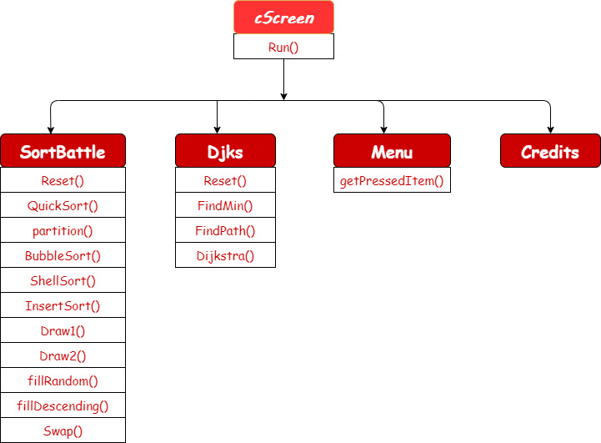
Project Overview
Class Diagram

Slide 15






Dependencies
C++
Github
SFML
Visual Studio
Sublime
Stack Overflow

Slide 16
DEMO:

Slide 17
THANK YOU

